Slide 1
Deep Learning
Session-1
02/05/2024
Deep learning
<number>
Notes:
<number>

Slide 2




AIM OF THE SESSION
To familiarize students with the basic concept of deep learning
INSTRUCTIONAL OBJECTIVES
This Session is designed to:
Describes the history of Deep learning
List out the applications of Deep learning
LEARNING OUTCOMES
At the end of this session, you should be able to:
Summarize history of deep learning
Identify the deep learning applications in real time

Slide 3
Contents
What is Deep Learning
Need of Deep Learning.
Machine learning vs Deep learning
Evolution of Deep Learning
Application of Deep learning
02/05/2024
Deep learning
<number>

Slide 4
What is Deep Learning (DL)
A machine learning subfield of learning representations of data. Exceptional effective at learning patterns.
Deep learning algorithms attempt to learn (multiple levels of) representation by using a hierarchy of multiple layers
If you provide the system tons of information, it begins to understand it and respond in useful ways.
Machine Learning is an approach or subset of Artificial Intelligence that is based on the idea that machines can be given access to data along with the ability to learn from it.
Deep Learning takes Machine Learning to the next level.
02/05/2024
Deep learning
<number>

Slide 5
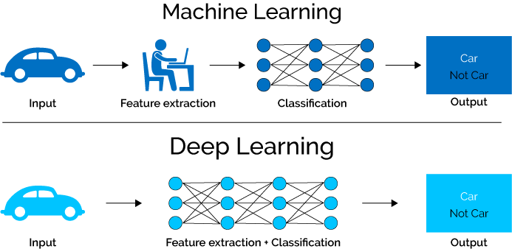
ML vs DL
02/05/2024
Deep learning
<number>

Slide 6
ML vs DL
Machine Learning | Deep Learning
Works on small amount of Dataset for accuracy. | Works on Large amount of Dataset.
Dependent on Low-end Machine. | Heavily dependent on High-end Machine.
Divides the tasks into sub-tasks, solves them individually and finally combine the results. | Solves problem end to end.
Takes less time to train. | Takes longer time to train.
Testing time may increase. | Less time to test the data
02/05/2024
Deep learning
<number>

Slide 7
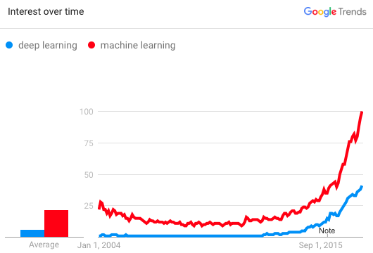
Why is DL useful?
Manually designed features are often over-specified, incomplete and take a long time to design and validate.
Learned Features are easy to adapt, fast to learn.
Deep learning provides a very flexible, (almost?) universal, learnable framework for representing world, visual and linguistic information.
Can learn both unsupervised and supervised.
Effective end-to-end joint system learning.
Utilize large amounts of training data.
In ~2010 DL started outperforming other ML techniques first in speech and vision, then NLP
02/05/2024
Deep learning
<number>

Slide 8
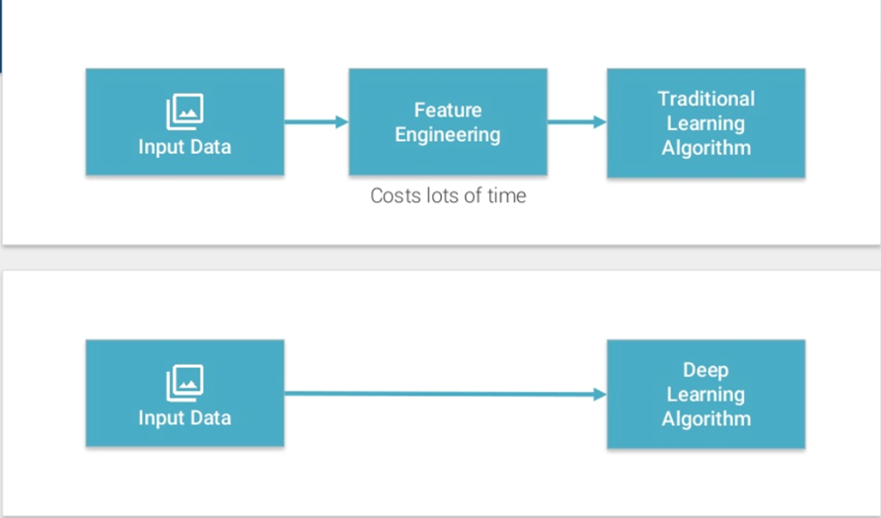
Deep Learning Basics
02/05/2024
Deep learning
<number>

Slide 9
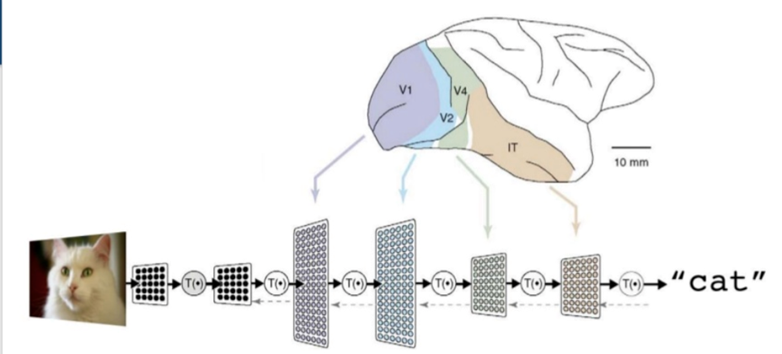
Deep Learning Basics (cont..)
A Deep neural network consists of a hierarchy of layers, where by each layer transforms the input data into more abstract representations (e.g. edge-> nose->face). The output layer combines those features to make predictions.
02/05/2024
Deep learning
<number>

Slide 10
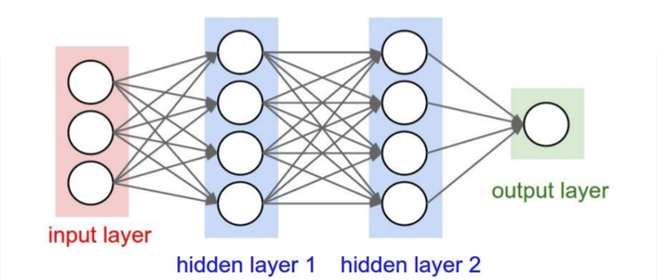
Deep Learning Basics (cont..) ANN
Consists of one input, one output and multiple fully-connected hidden layers in-between. Each layer is represented as a series of neurons and progressively extracts higher and higher-level features of the input until the final layer essentially makes a decision about what the input shows. The more layers the network has, the higher level features it will learn.
02/05/2024
Deep learning
<number>

Slide 11
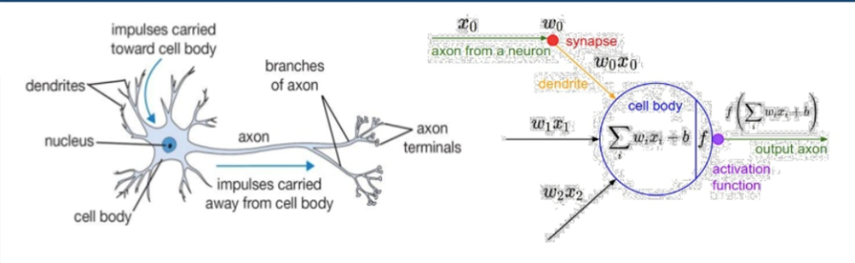
Artificial Neural Network
An Artificial Neuron contains a nonlinear activation function and has several incoming and outgoing weighted connections.
Neurons are trained to filter and detect specific features or patterns (e.g. edge, nose) by receiving weighted input, transforming it with the activation function and passing it to the outgoing connections.
02/05/2024
Deep learning
<number>

Slide 12
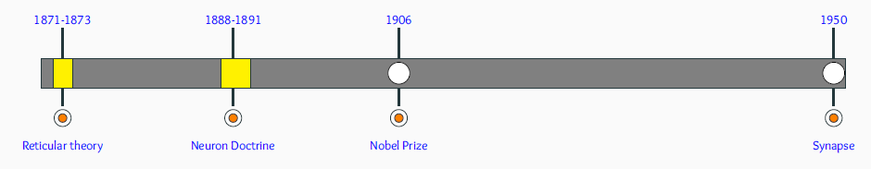
Deep Learning History
Reticular Theory: Joseph von Gerlach proposed that the nervous system is a single continuous network as opposed to a network of many discrete cells!
Staining Technique: Camillo Golgi discovered a chemical reaction that allowed him to examine nervous tissue in much greater detail than ever before He was a proponent of Reticular theory.
Neuron Doctrine: Santiago Ramón y Cajal used Golgi’s technique to study the nervous system and proposed that it is actually made up of discrete individual cells forming a network (as opposed to a single continuous network).
02/05/2024
Deep learning
<number>

Slide 13
Deep Learning History (cont..)
The Term Neuron: The term neuron was coined by Heinrich Wilhelm Gottfried von Waldeyer-Hartz around 1891. He further consolidated the Neuron Doctrine.
Nobel Prize: Both Golgi (reticular theory) and Cajal (neuron doctrine) were jointly awarded the 1906 Nobel Prize for Physiology or Medicine, that resulted in lasting conflicting ideas and controversies between the two scientists.
The Final Word: In 1950s electron microscopy finally confirmed the neuron doctrine by unambiguously demonstrating that nerve cells were individual cells interconnected through synapses (a network of many individual neurons).
02/05/2024
Deep learning
<number>

Slide 14
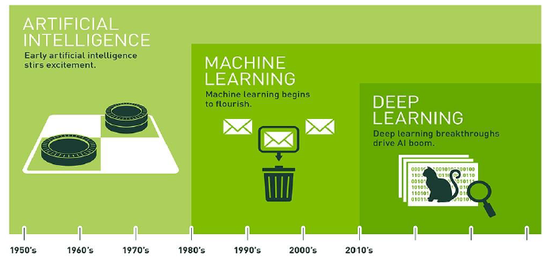
Evolution of Deep Learning
02/05/2024
Deep learning
<number>
Notes:
<number>

Slide 15
Deep Learning Evolution
1943: An artificial neuron was proposed as a computational model of the “nerve net” in the brain by Warren McCulloch, Walter Pitts
Late 1950s: A neural network application by reducing noise in phone lines was developed by Bernard Widrow, Ted Hoff
Late 1950s: The Perceptron was introduced. It mimicked the neural structure of the brain and showed an ability to learn by Frank Rosenblatt
1969: Proved mathematically that the Perceptron could only perform very basic tasks. It was published in their book, “Perceptrons”. They also discussed the challenges in relation to training multi-layer neural networks. by Marvin Minsky, Seymour Papert
1986: Solved the training challenges of multi-layer neural network using back propagation training algorithm by David E. Rumelhart, Geoffrey E. Hinton, and Ronald J. Williams.
1998: Made the Use of neural networks on image recognition tasks. Defined the concept of convolutional neural networks (CNN), in his paper, which mimic the human visual cortex by Yann LeCun.
02/05/2024
Deep learning
<number>

Slide 16
Deep Learning Evolution(Cont..)
1998: Popularized the “Hopfield” network which was the first recurrent neural network (RNN) by John Hopfield
1997 – 1998: Introduced long short-term memory (LSTM), greatly improving the efficiency and the practicality of recurrent neural networks (RNN) by Jurgen Schmidhuber and Sepp Hochreiter
2012: Highlighted the power of deep learning by showing significant results in the well-known ImageNet competition by Geoffrey Hinton and two of his students
2012 – 2103: Breakthrough work on large scale image recognition at Google Brain by Jeffrey Dean, Andrew Ng
2014: Published his paper on generative adversarial networks (GAN)by Ian Goodfellow
2014: Reinforcement learning: An Introduction by Richard S. Sutton, Andrew G. Barto.
Refer: https://github.com/ChristosChristofidis/awesome-deep-learning
02/05/2024
Deep learning
<number>

Slide 17


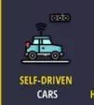
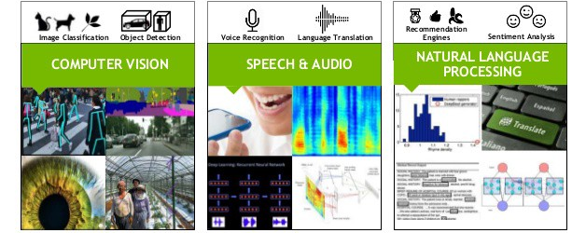
Deep Learning Applications
Virtual Assistants
Chatbots
Healthcare .
Entertainment
News Aggregation and Fake News Detection
Composing Music
Image Captioning
Self driving car
Advertising
Robotics
…………………..
02/05/2024
Deep learning
<number>

Slide 18

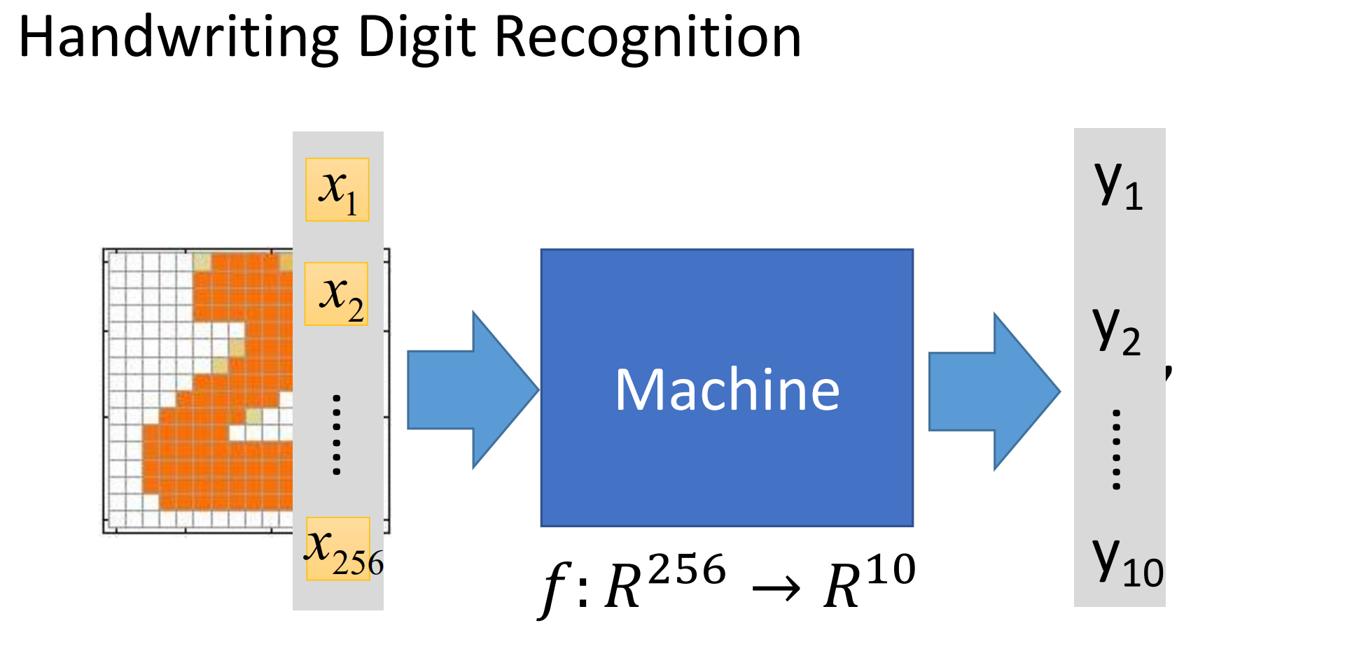
02/05/2024
Deep learning
<number>

Slide 19
A. Self-driving cars
B. Pattern recognition
C. Natural language processing
D. All of the above
SELF-ASSESSMENT QUESTIONS
Which of the following is an example of deep learning
Pattern recognition
Self-driving cars
Natural language processing
D. All of the above…
Which of the following is a deep learning library
Tensorflow
Keras…
PyTorch
All of the above

Slide 20
SELF-ASSESSMENT QUESTIONS
Outline the history of deep learning
What is the need for deep learning
List out the differences between DL and ML
Illustrate Real time deep learning applications
02/05/2024
Deep learning
<number>

Slide 21
REFERENCES FOR FURTHER LEARNING OF THE SESSION
https://www.youtube.com/watch?v=6XhSJbfT1pk
https://www.analyticsinsight.net/the-history-evolution-and-growth-of-deep-learning/
02/05/2024
Deep learning
<number>

